Slide 1
Signature discovery using multi-omics data approach in Acute Myeloid Leukemia using unsupervised learning

Slide 2
Steps Taken in our Project
Gather information and research on the topic using academic articles and papers
Download and preprocess data (methylation and gene expression data) from TCGA using TCGA Biolink
Perform Similarity Network Fusion (SNF) on the data
Perform Clustering using unsupervised learning
Perform Differential Expression Analysis
Perform Enrichment Analysis
Extract signatures

Slide 3
Step 1:
Research on Topic

Slide 4
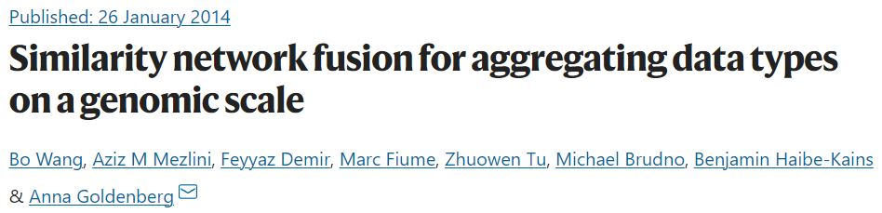
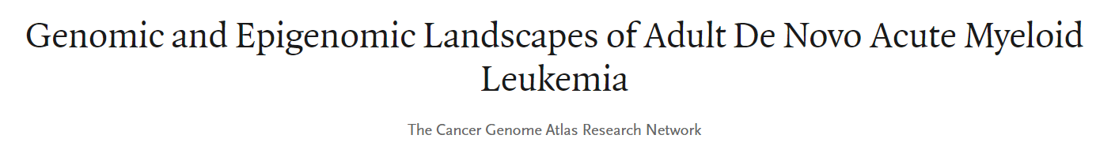
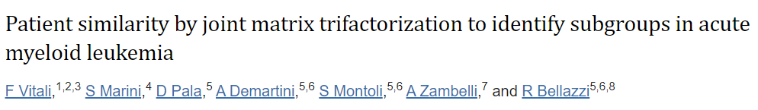
Literature and Research Papers Studied

Slide 5
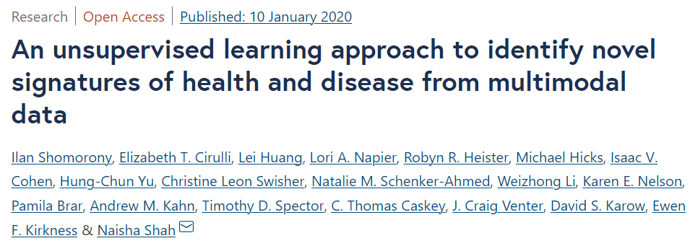
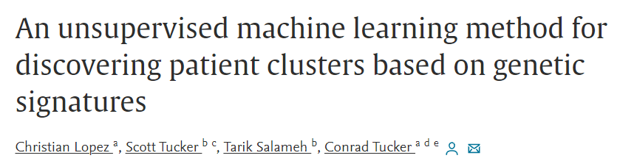
Literature and Research Papers Studied

Slide 6
Step 2:
Download and Preprocess Data

Slide 7
TCGA biolink
The TCGA Biolink R package simplifies cancer research by providing easy access to genomic and clinical data from the TCGA project.
It includes tools for data quality control, normalization, and visualization, and allows analysis of various types of omics data, including gene expression, somatic mutation, DNA methylation, and clinical information.
It also offers an integrative analysis of multiple omics data types.
For our Project, we have chosen the TCGA-LAML project

Slide 8
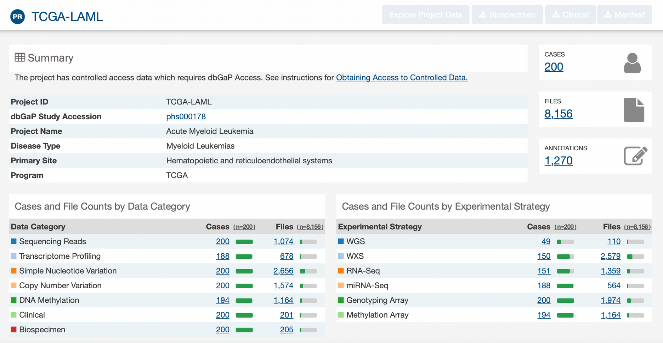
TCGA-LAML Project Used

Slide 9
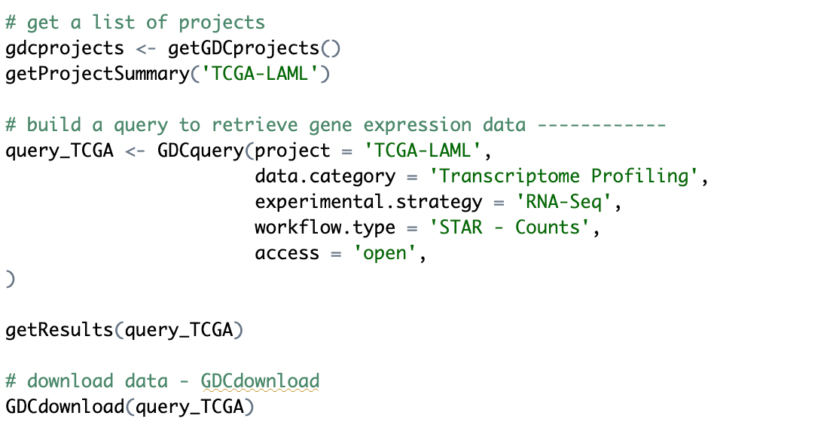
Download Data from TCGA

Slide 10
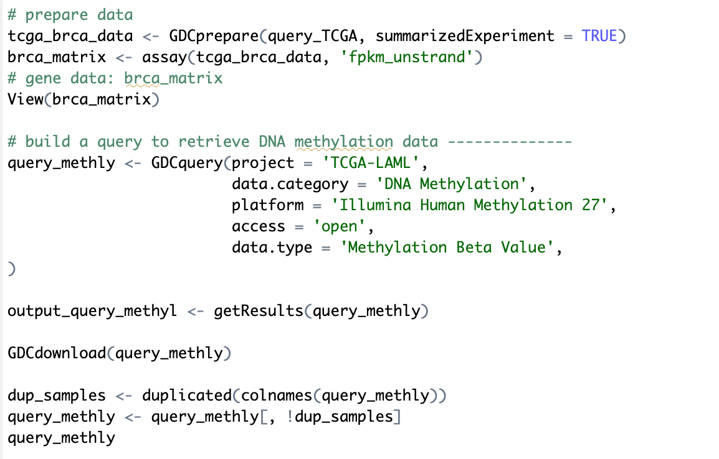
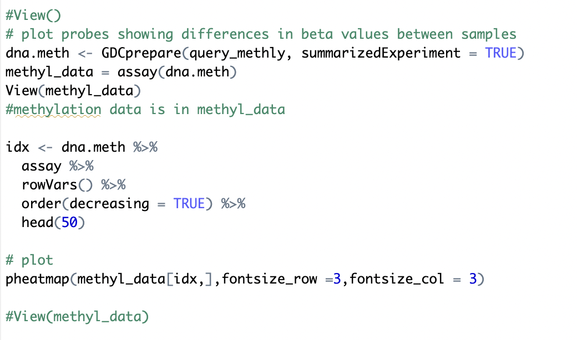
Preprocess the Methylation and Gene Expression Data

Slide 11
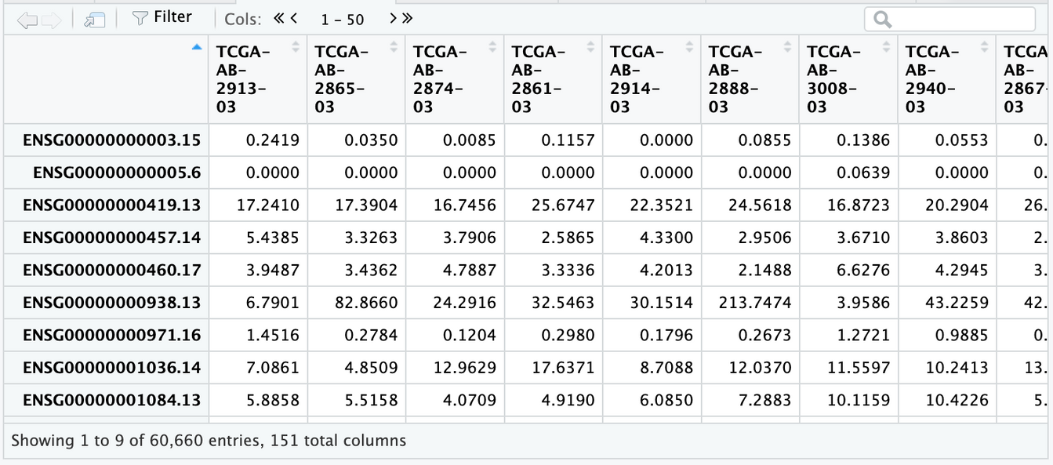
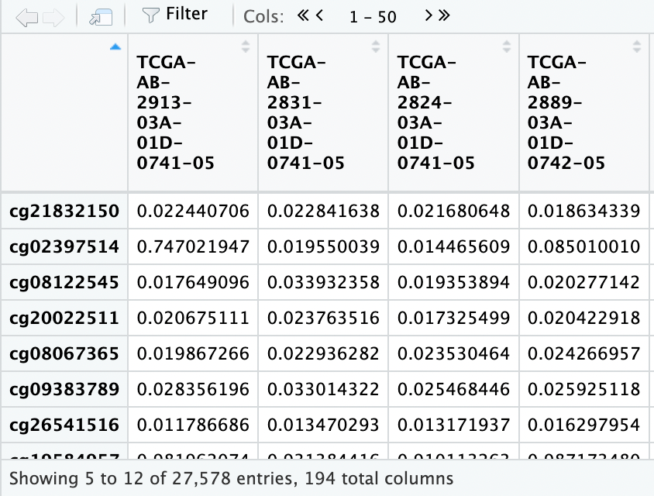
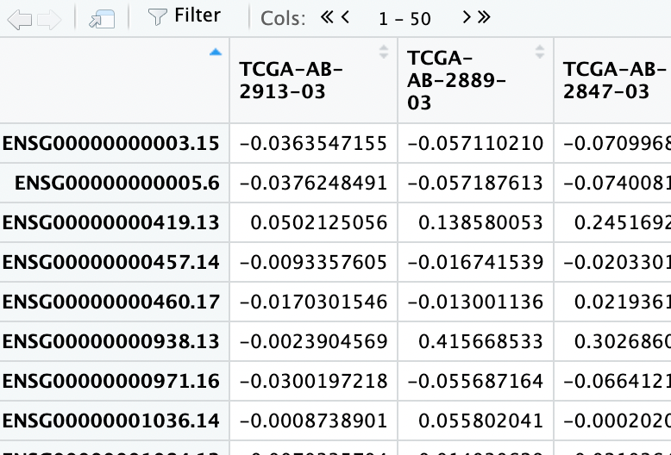
BRCA Matrix, Methyl Data and Gene Data

Slide 12
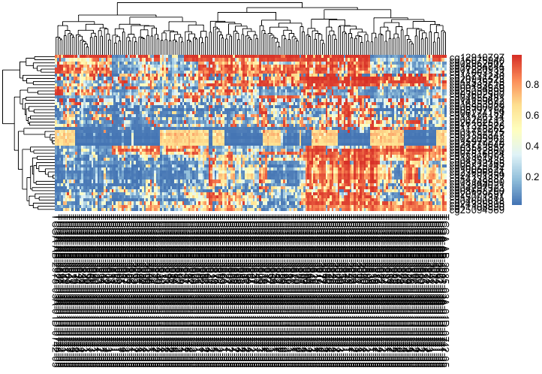
DNA Methylation HeatMap
Shows Methylation of each Probe, Red indicates high methylation while blue indicates low methylation

Slide 13
Step 3:
Similarity Network Fusion

Slide 14
Used Similarity Network Fusion (SNF) algorithm to integrate the gene expression and DNA methylation data using a hyperparameter alpha, number of neighbors K, and number of iterations T.
We first normalized and scaled the gene expression and DNA methylation data and calculated the distance matrices using the Correlation and Euclidean distance measures, respectively.
Then, we calculated the Affinity Matrices for each data type using the SNFtool::affinityMatrix() function.
Finally, we used the SNFtool::SNF() function to perform SNF on the principal component matrices, resulting in a fused matrix that integrates the gene expression and DNA methylation data.

Slide 15
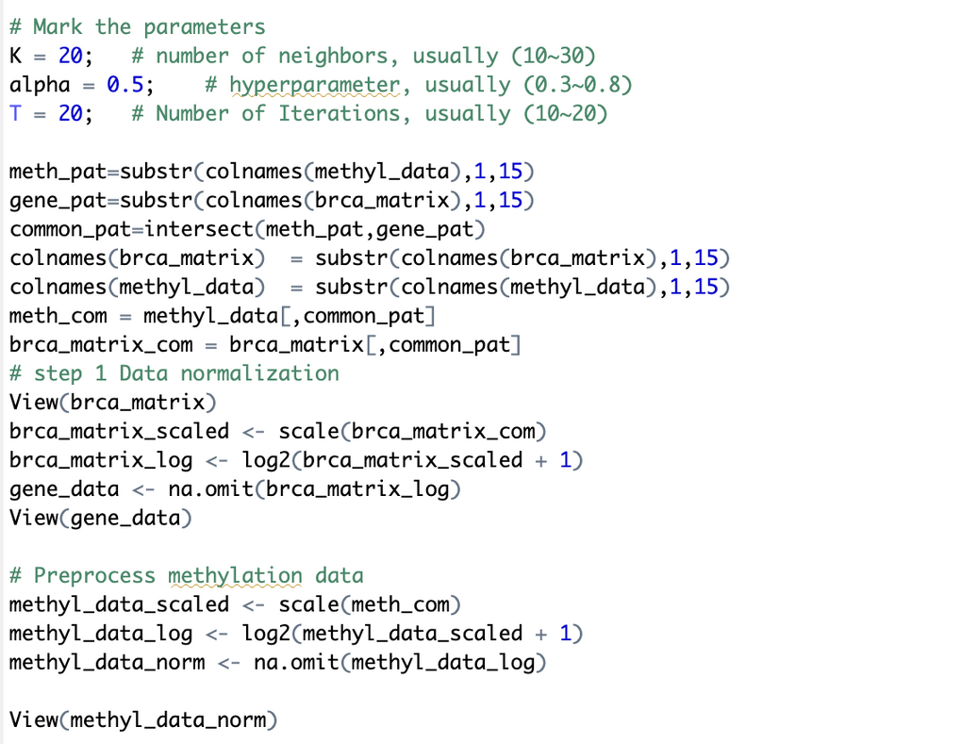
Data Normalisation and Preprocessing

Slide 16
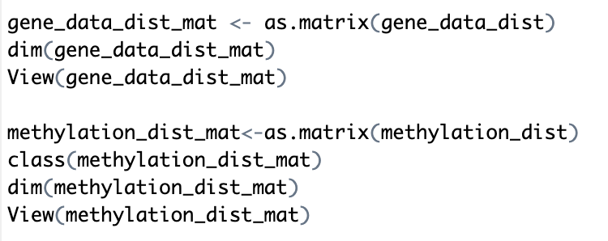
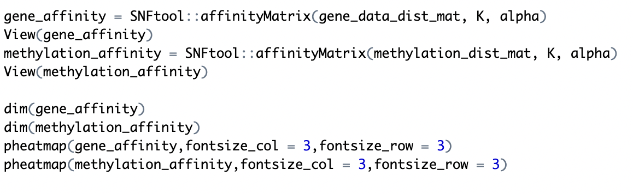
Calculating Distance and Affinity Matrices
Distance Matrices:
Affinity Matrices:

Slide 17
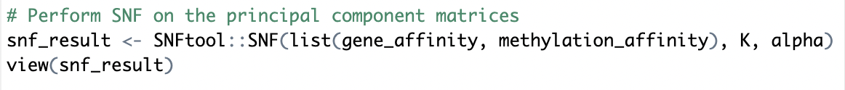
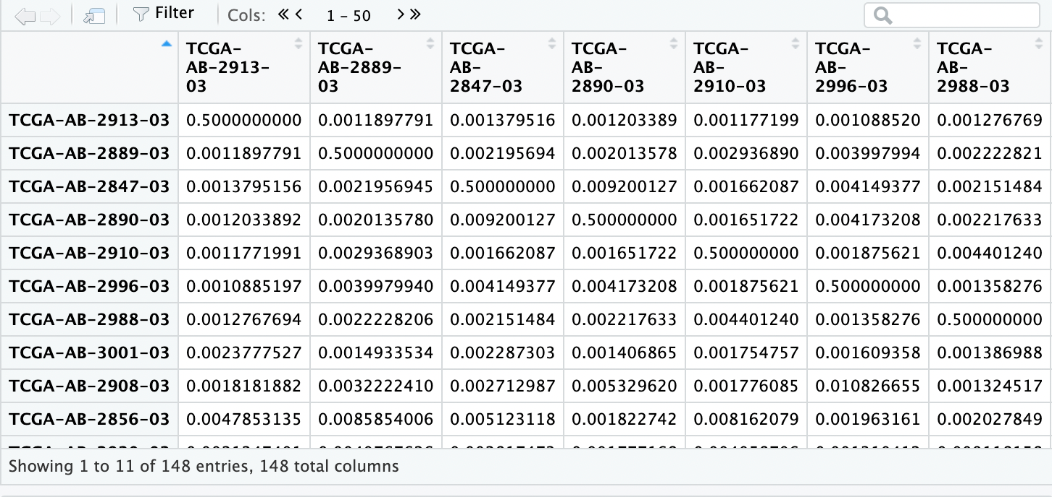
Performing SNF
Results:

Slide 18
Step 4:
Clustering

Slide 19
We used Spectral Clustering.
Calculated the average silhouette width for each number of clusters in a given range.
The optimal number of clusters is determined based on the highest average silhouette width in the range.
We found the value as 7.
Using this value of the average silhouette width, spectral clustering was performed.

Slide 20
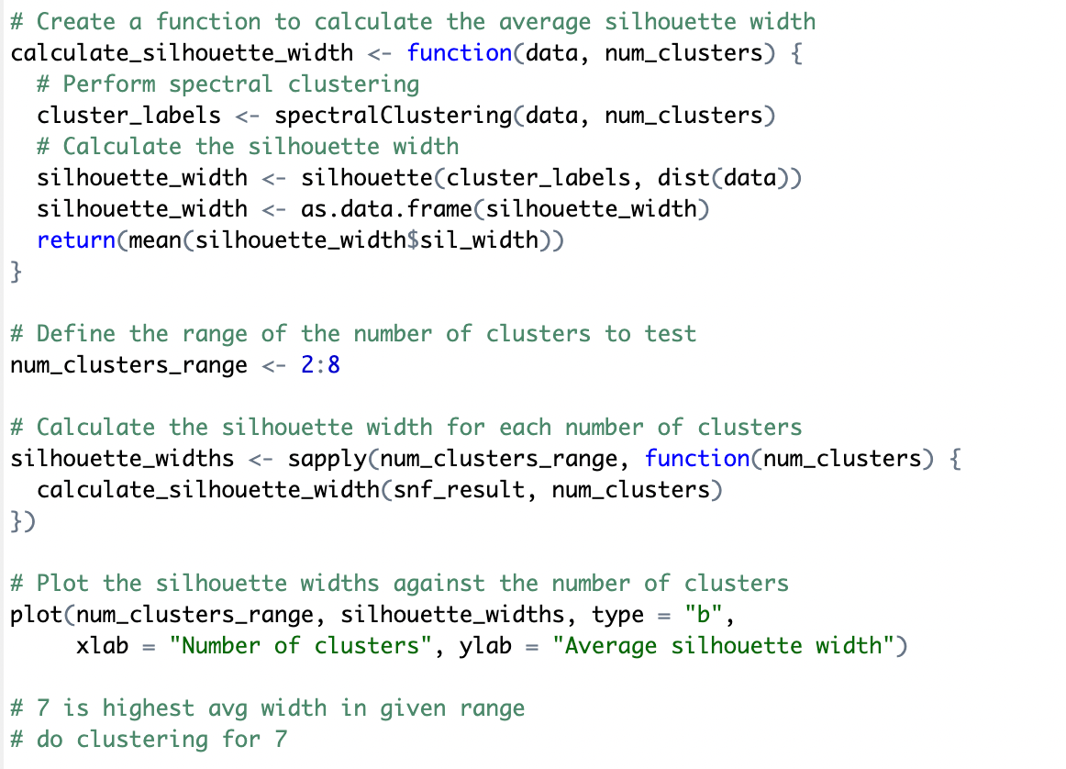
Finding the Average Silhouette Width

Slide 21
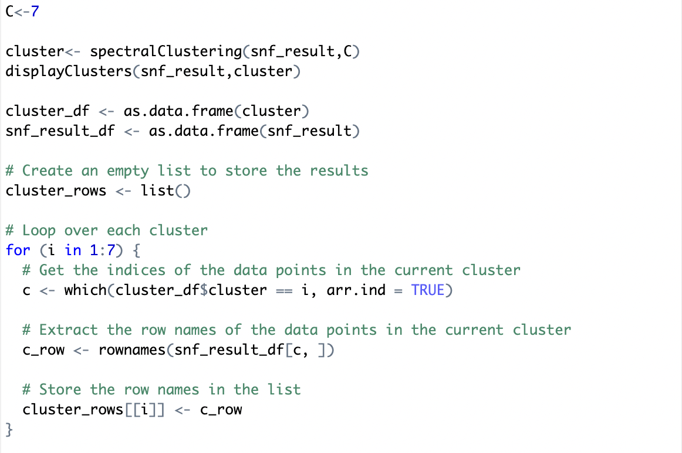
Performing Clustering

Slide 22
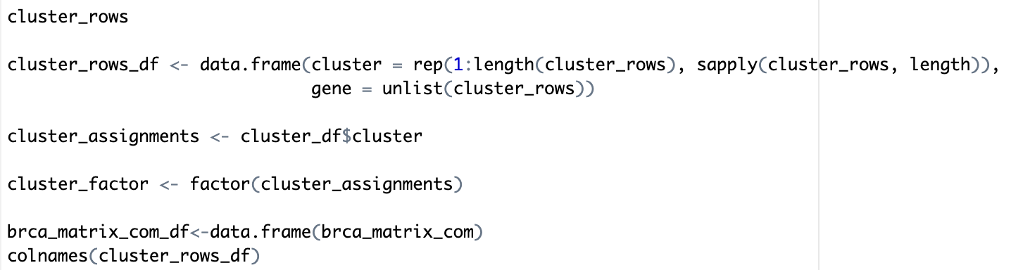
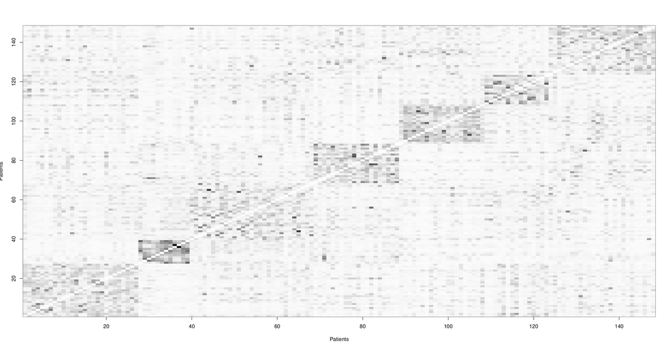
View The Results

Slide 23
Step 5:
Differential Expression Analysis

Slide 24
We performed Differential Expression Analysis after clustering of gene expression data using the limma and edgeR packages in R.
We created a DGEList object from the gene expression data and a design matrix based on the cluster assignments.
We used voom function to transform the data, then fit a linear model and used empirical Bayes moderation to calculate moderated t-statistics.
We used the topTable function to extract the significant genes, then calculated the log fold change for each cluster.
We created an enhanced volcano plot to visualize the results, filters for significant genes, and created a gene list ordered by log fold change.

Slide 25
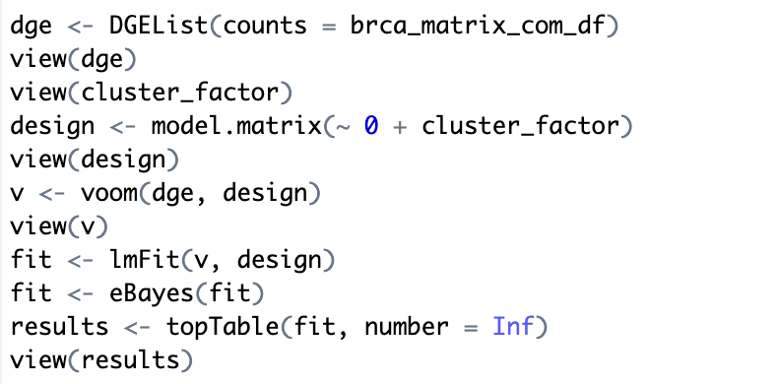
Extracting the Significant Genes

Slide 26
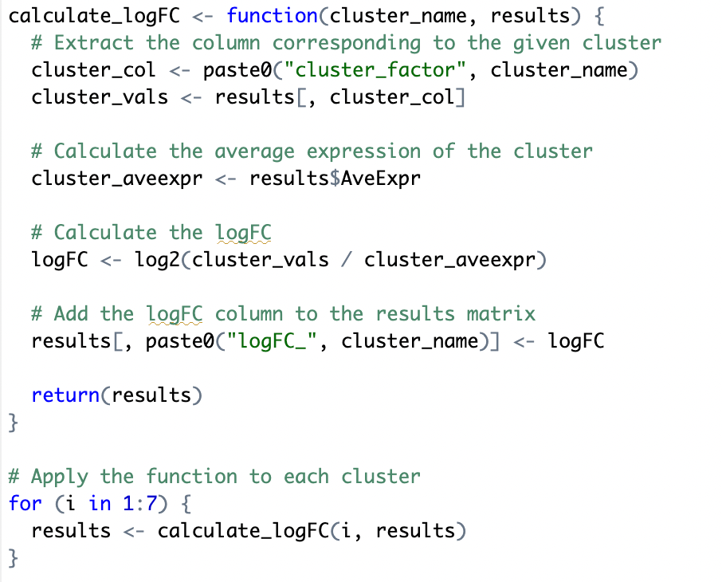
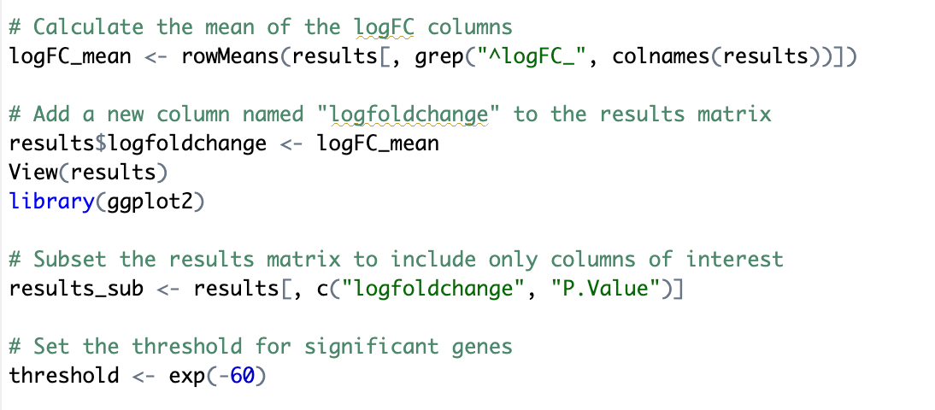
Log Fold Change
Function to calculate log fold change and apply to each cluster:
Calculate mean log fold change and add to matrix

Slide 27
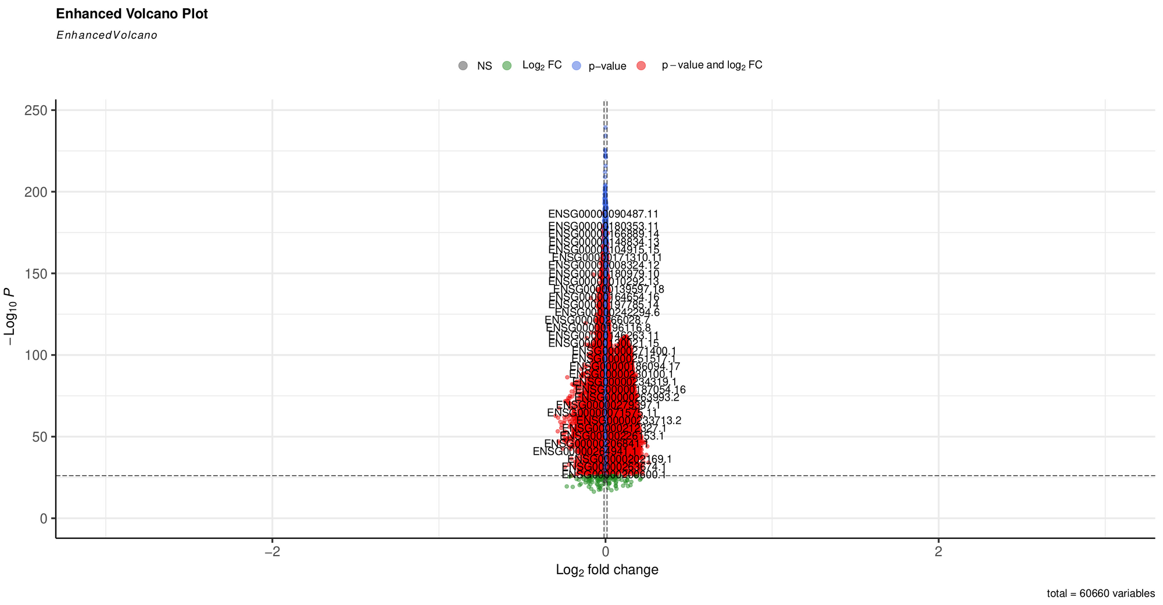
Volcano Plot

Slide 28
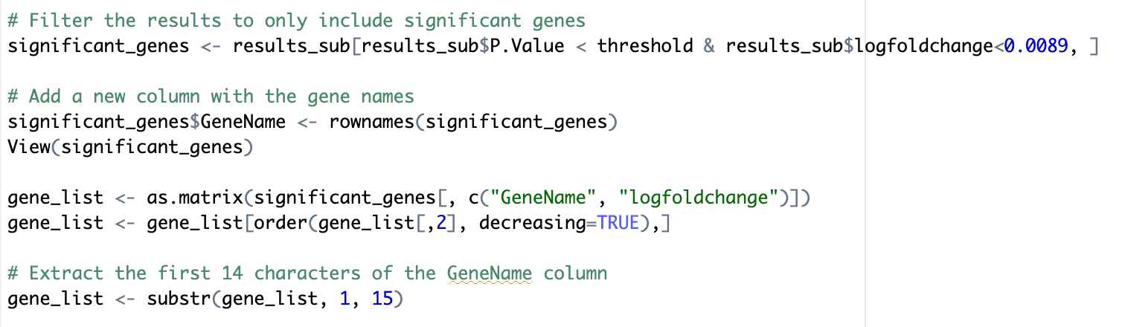
Getting the Significant Genes as Result

Slide 29
Step 6:
Enrichment Analysis

Slide 30
We performed gene ontology (GO) enrichment analysis on the significant genes identified in the differential expression analysis.
The enrichGO() function from the clusterProfiler package was used to perform the enrichment analysis.
Two visualization functions, dotplot() and barplot(), from the clusterProfiler package are used to create a dot plot and a bar plot of the enriched GO terms. These plots show the significantly enriched GO terms and the number of genes associated with each term.

Slide 31
Step 7:
Extracting Signatures and Analysing Results

Slide 32
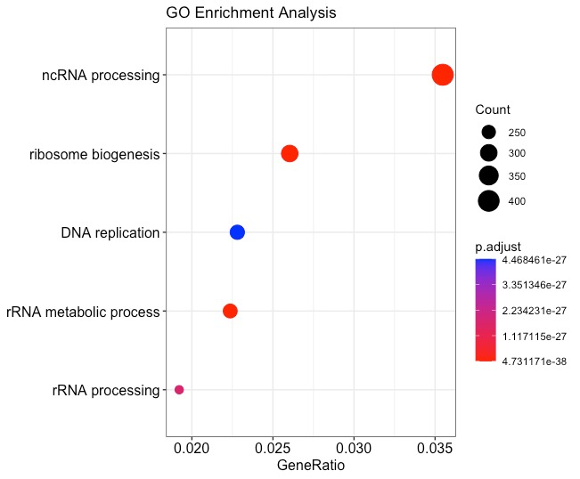
Dot Plot

Slide 33
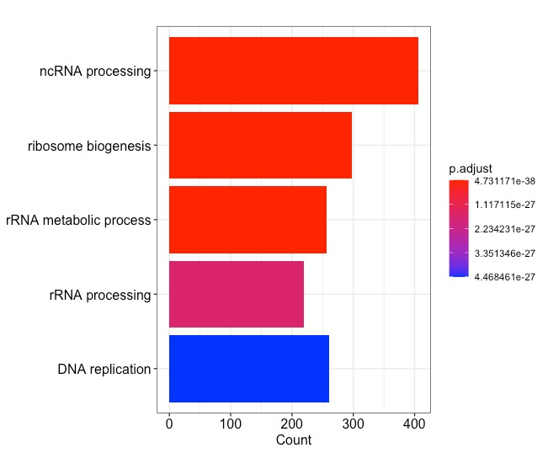
Bar Plot

Slide 34
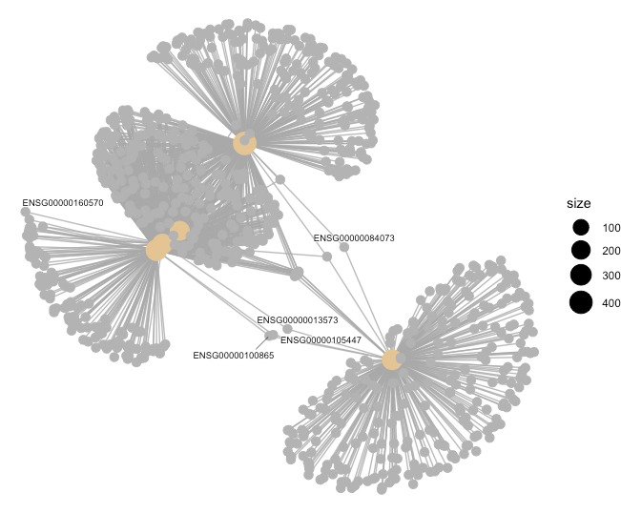
CNET Plot

Slide 35
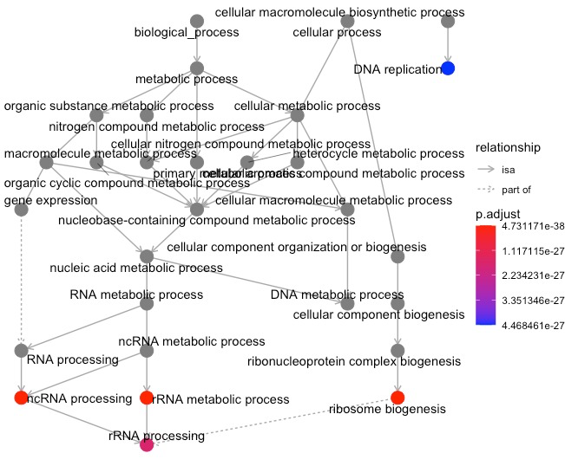
GO Plot

Slide 36
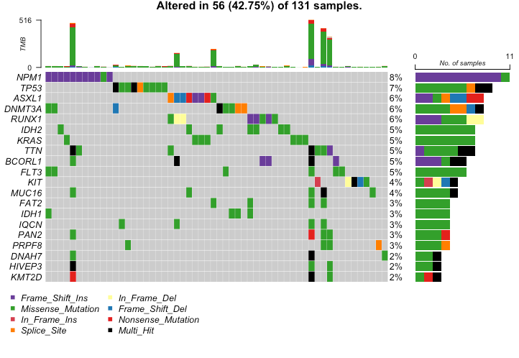
Onco Plot
Shows the top genes that had Mutations for LAML

Slide 37
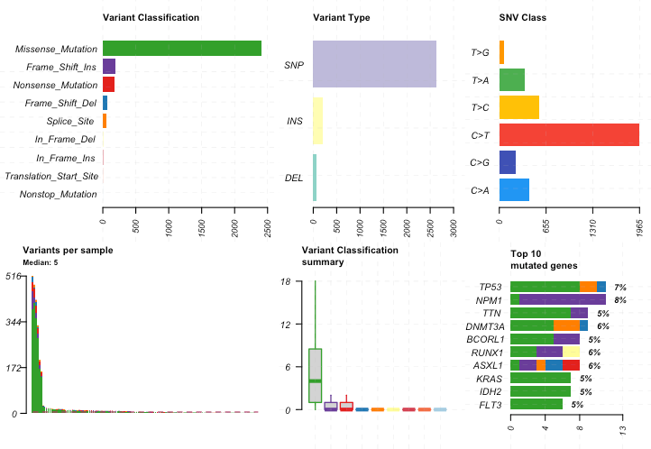
Mutation Plot

